Slide 1

Vaccine Management System
(Drug_Lordv1.10)

Slide 2

Table of Contents
Introduction
Analysis of Survey
About the Vaccination System
Requirements
Conclusion
References

Slide 3

Introduction
Background.
The proposed System.

Slide 4

Background
The current Vaccination Systems which are used are not centralized i.e., the data generated is confined to an organization or a company except due to a recent pandemic newer methods are cultivated
https://www.servicenow.com/solutions/vaccine-management.htm
https://www2.deloitte.com/us/en/pages/public-sector/solutions/vaccine-management-system.htm
https://www.intelex.com/products/applications/vaccine-management}{Intelex Vaccine Solution

Slide 5
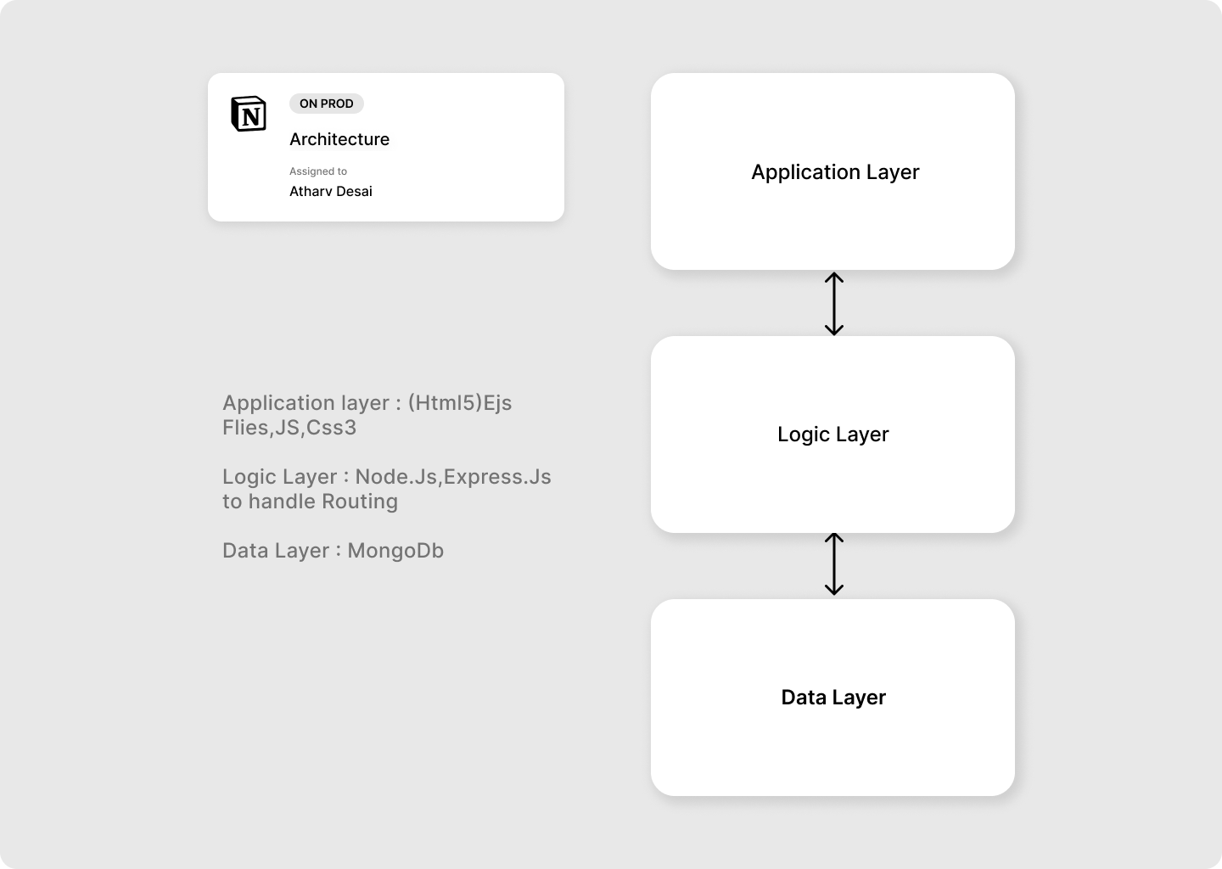
The Proposed System
The main purpose of this project is to help benefit NGOs in providing vaccine access to rural areas people without using many resources, by providing verified personnel of NGOs or any individual to request access to medical vaccines under the guidance of a medical practitioner.
Creating a platform for all domestic producers to sell their vaccines to local consumers, NGOs, etc, and to simplify the delivery process, regulations and management.

Slide 6

Analysis of Survey
The survey Done.
Conclusion of the Survey.

Slide 7
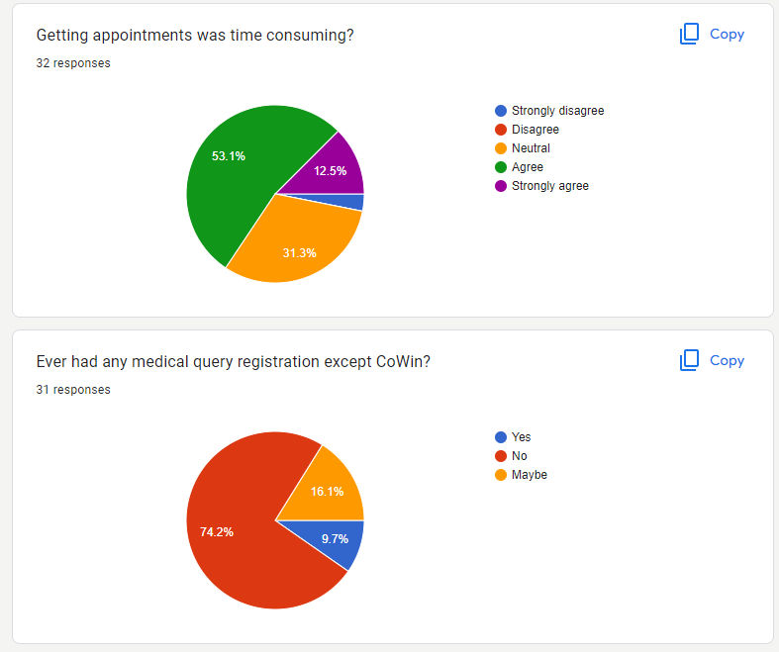
The Survey Done
For the current situation User’s Feedback method to identify the requirements for the project using Google Forms as a means to collect the data
Informal interviews with colleagues and friends

Slide 8

Conclusion From the Survey
No such platform was present which was commercially in use for such purposes
Minor such systems are used by large MNCs for the staff

Slide 9

About the Vaccination System
Description
Scalability

Slide 10
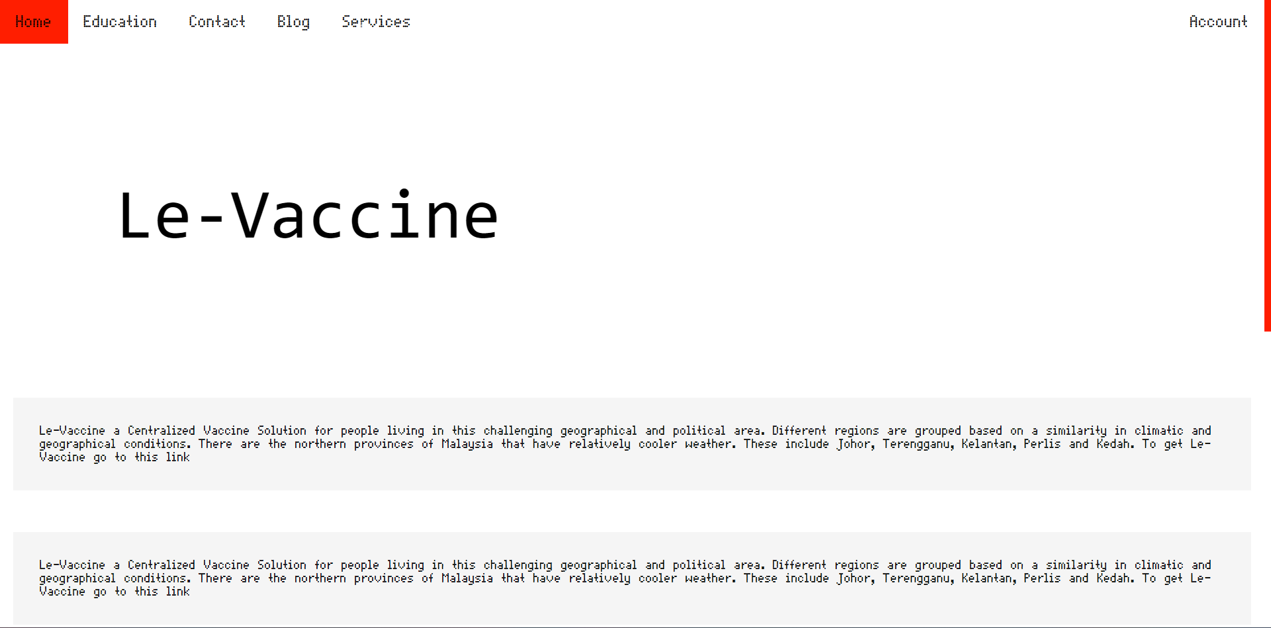
Description
The system should allow users to fill up for an appointment in their locality
The system should keep a detailed record of user’s info
The system should allow users to note any problems after vaccination is completed
The system should provide Producers, NGOs, and Companies to order and sell their vaccines
The system should keep a detailed record of all domestic producers, providers and along with the info of users
Concept idea

Slide 11

Scalability
Unlike SQL databases, where you must determine and declare a table's schema before inserting data, MongoDB's collections, by default, do not require their documents to have the same schema. That is:
The documents in a single collection do not need to have the same set of fields and the data type for a field can differ across documents within a collection.

Slide 12
Requirements
Software
Hardware

Slide 13




Software
System O.S: Window or Linux (Debian or Arch).
Frontend: HTML(ejs),JS, TailwindCss.
Backend: Node.js,Express.js
Database: MongoDB (NoSql)
(Le-Vaccine)

Slide 14
Hardware
Processor: Intel Core 3.0 2.3 GHz or more.
RAM: 4GB or more.
Monitor: 17 CRT or LCD, Plasma, etc.
Hard-Disk: 256 or more (SSD preferable)
Keyboard: Normal or multimedia.
Mouse: Compatible

Slide 15
Conclusion
Scope
Contribution

Slide 16
Scope
Contribution
Creating a platform for all domestic producers to sell their vaccines to local consumers, NGOs, etc, and to simplify the delivery process, regulations and management.
The idea can be fundamentally used in any management system of products in any medical field.
Through this project, I will get to learn various technologies used to develop a system. This system will give a digital platform to the all-Domestic producers of vaccines which will increase the vaccine production rate and simplify the delivery process as well as help them to manage their data. Once they get satisfactory results from the system, users will start trusting the system and eventually, most of the tasks will get digital. Encourage B2B and C2C relations

Slide 17
References
https://cdsco.gov.in/opencms/export/sites/CDSCO_WEB/Pdf-documents/biologicals/facilitiesLIST.pdf
https://www.who.int/emergencies/diseases/novel-coronavirus-2019/question-and-answers-hub/q-a-detail/coronavirus-disease-(covid-19)-vaccines?adgroupsurvey={adgroupsurvey}
https://www.servicenow.com/solutions/vaccine-management.htm
https://www2.deloitte.com/us/en/pages/public-sector/solutions/vaccine-management-system.htm
https://www.mongodb.com/docs/manual/core/data-modeling-introduction/

Slide 18
Thank you

